Slide 1
NLH Update

Slide 2
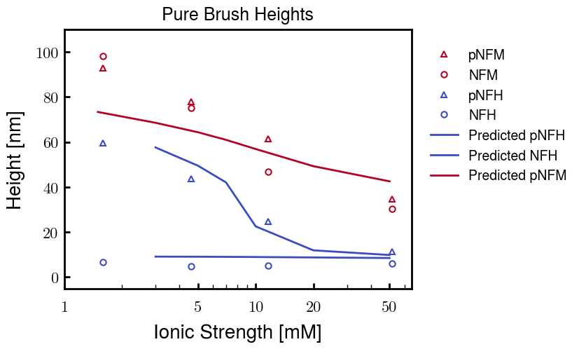
Trends captured, but NFM at low Cs is too short

Slide 3
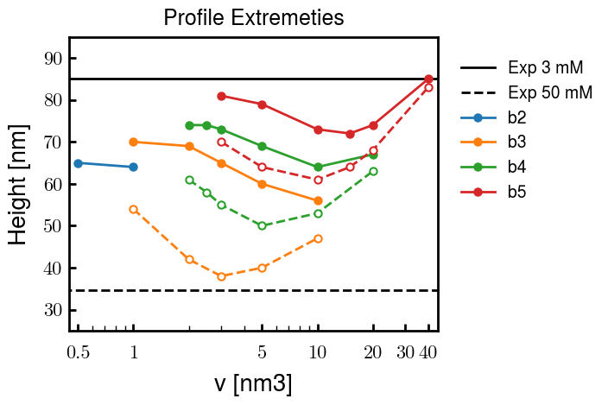
Analysis of other b and v values: Comparison of heights at 3 mM (solid lines) and 50 mM (dashed)
b = 2.0 nm
b = 3.0, v = 2.0 used for results on prev. slide

